Slide 1

ASHRAE - Great Energy Predictor III
Team 16: Koby Arndt, Casey Clark, Nick Ohlheiser, and Sean Powell

Slide 2


Competition Overview
Predict metered building energy uses
Why? - to quantify the difference between real energy consumption and how much energy would’ve been used before any retrofitting
Evaluation Metric - Root Mean Squared Logarithmic Error

Slide 3
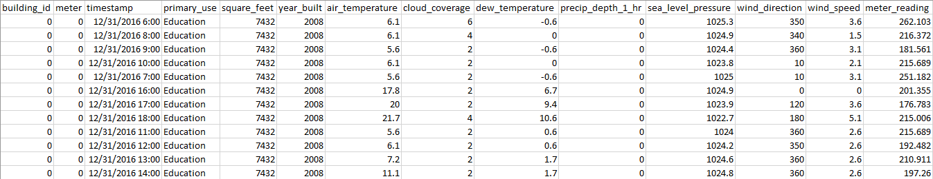
The Data
Provided by ASHRAE, 3 separate files:
Meter information & reading
Building specifications
Local weather conditions during the reading
4 meter types; Nearly 1,500 buildings; 3 year time frame

Slide 4
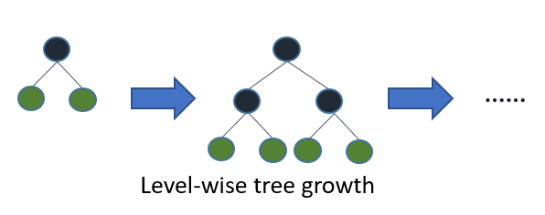
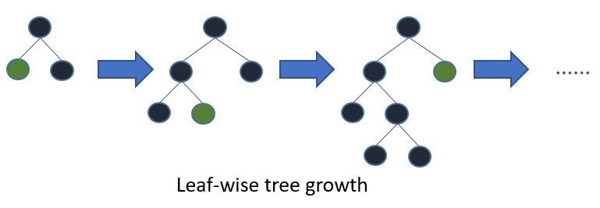
Notes:
Model Critique - AC/DC

Slide 5
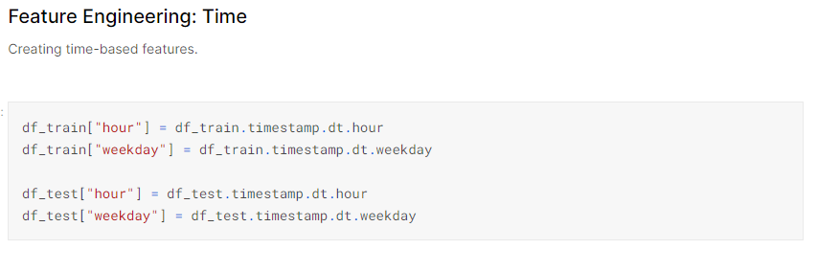
Model Critique - Ashrae: Divide and Conquer
Gradient boosting model written in python that performed well.
Highlight was feature engineering.

Slide 6
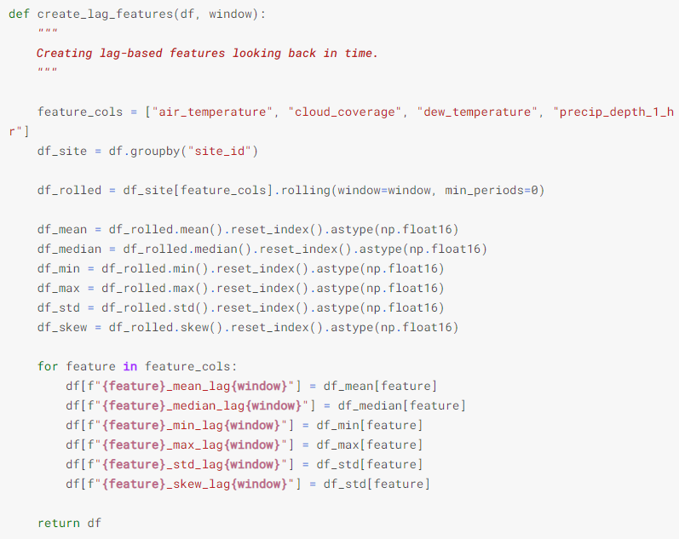

Slide 7
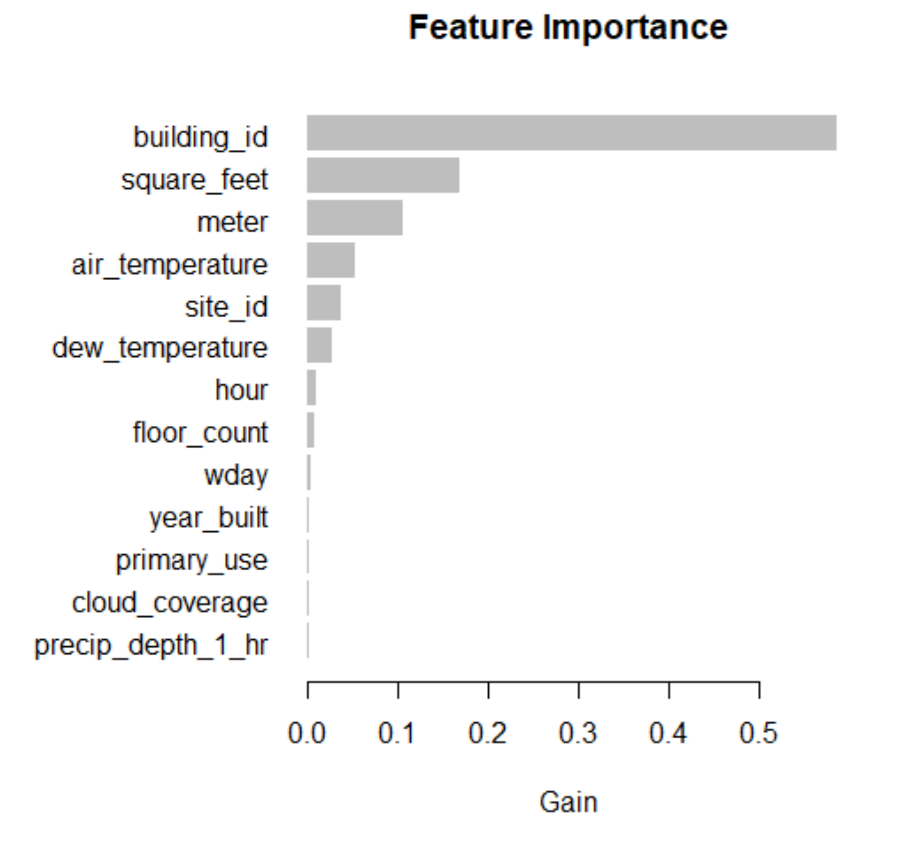
Notes:
ac/dc feature importance

